Slide 1
Introduction to AI(Artificial Intelligence)
Md. Alamgir Hossain
Senior Lecturer
Dept. of CSE, Prime University
Mail: alamgir.cse14.just@gmail.com

Slide 2

Definition of AI(Artificial Intelligence)
AI is one of the fascinating and universal fields of Computer science which has a great scope in future. AI holds a tendency to cause a machine to work as a human.
Artificial Intelligence is composed of two words Artificial and Intelligence, where Artificial defines “man-made” and intelligence defines “thinking power”, hence AI means “a man-made thinking power”.
So, we can define AI as: “It is a branch of computer science by which we can create intelligent machines which can behave like a human, think like humans, and able to make decisions”.
It is currently working with a variety of subfields, ranging from general to specific, such as self-driving cars, playing chess, proving theorems, playing music, Painting, etc.

Slide 3
Why AI(Artificial Intelligence)??
With the help of AI, you can create such software or devices which can solve real-world problems very easily and with accuracy such as health issues, marketing, traffic issues etc.
With the help of AI, you can create your personal virtual Assistant, such as Cortana, Google Assistant, Siri etc.
With the help of AI, you can build such Robots which can work in an environment where survival of humans can be at risk.
AI opens a path for other new technologies, new devices, and new Opportunities.

Slide 4
Goals of AI(Artificial Intelligence)??
Replicate human intelligence
Solve Knowledge-intensive tasks
An intelligent connection of perception and action
Building a machine which can perform tasks that requires human intelligence such as:
Proving a theorem
Playing chess
Plan some surgical operation
Driving a car in traffic
Creating some system which can exhibit intelligent behavior, learn new things by itself, demonstrate, explain, and can advise to its user.

Slide 5
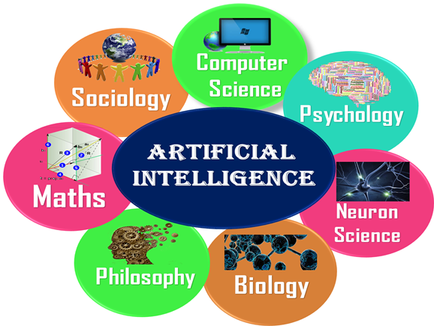
What Comprises to AI(Artificial Intelligence)??
To create the AI first we should know that how intelligence is composed, so the Intelligence is an intangible part of our brain which is a combination of Reasoning, learning, problem-solving perception, language understanding, etc.

Slide 6
Advantages of AI(Artificial Intelligence)??
High Accuracy with less errors: AI machines or systems are prone to less errors and high accuracy as it takes decisions as per pre-experience or information.
High-Speed: AI systems can be of very high-speed and fast-decision making, because of that AI systems can beat a chess champion in the Chess game.
High reliability: AI machines are highly reliable and can perform the same action multiple times with high accuracy.
Useful for risky areas: AI machines can be helpful in situations such as defusing a bomb, exploring the ocean floor, where to employ a human can be risky.
Digital Assistant: AI can be very useful to provide digital assistant to the users such as AI technology is currently used by various E-commerce websites to show the products as per customer requirement.
Useful as a public utility: AI can be very useful for public utilities such as a self-driving car which can make our journey safer and hassle-free, facial recognition for security purpose, Natural language processing to communicate with the human in human-language, etc.

Slide 7
Disadvantages AI(Artificial Intelligence)??
High Cost: The hardware and software requirement of AI is very costly as it requires lots of maintenance to meet current world requirements.
Can’t think out of the box: Even we are making smarter machines with AI, but still they cannot work out of the box, as the robot will only do that work for which they are trained, or programmed.
No feelings and emotions: AI machines can be an outstanding performer, but still it does not have the feeling so it cannot make any kind of emotional attachment with human, and may sometime be harmful for users if the proper care is not taken.
Increase dependency on machines: With the increment of technology, people are getting more dependent on devices and hence they are losing their mental capabilities.
No Original Creativity: As humans are so creative and can imagine some new ideas but still AI machines cannot beat this power of human intelligence and cannot be creative and imaginative.

Slide 8



What Can AI Do?
Play a decent game of table tennis?
Play a decent game of Jeopardy?
Drive safely along a curving mountain road?
Buy a week’s worth of groceries on the web?
Buy a week’s worth of groceries at Publix?
Discover and prove a new mathematical theorem?
Converse successfully with another person for an hour?
Perform a surgical operation?
Put away the dishes and fold the laundry?
Translate spoken Chinese into spoken English in real time?
Write an intentionally funny story?

Slide 9
Unintentionally Funny Stories
One day Joe Bear was hungry. He asked his friend Irving Bird where some honey was. Irving told him there was a beehive in the oak tree. Joe walked to the oak tree. He ate the beehive. The End.
Once upon a time there was a dishonest fox and a vain crow. One day the crow was sitting in his tree, holding a piece of cheese in his mouth. He noticed that he was holding the piece of cheese. He became hungry, and swallowed the cheese. The fox walked over to the crow. The End.

Slide 10
AI in Decision Making
Scheduling, e.g. airline routing, military
Route planning, e.g. Google maps
Medical diagnosis
Web search engines
Spam classifiers
Automated help desks
Fraud detection
Product recommendations
… Lots more!

Slide 11
Thank You

